Slide 1
Social Media and Tanning
Rachel Duggan, Thao Le, Emily Lynch, Allison Pelletier

Slide 2
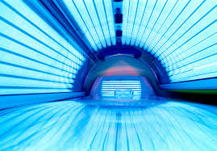
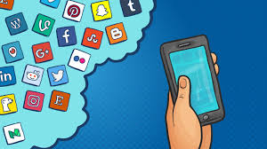
Research Objective
We wanted to see the the correlation between social media use and tanning among college students.
Hypothesis: a college student who uses social media more is more likely to tan more.
Looking further into this research question we will look at factors of race, skin type, hours on social media, types of social media used and their knowledge of tanning exposure.

Slide 3
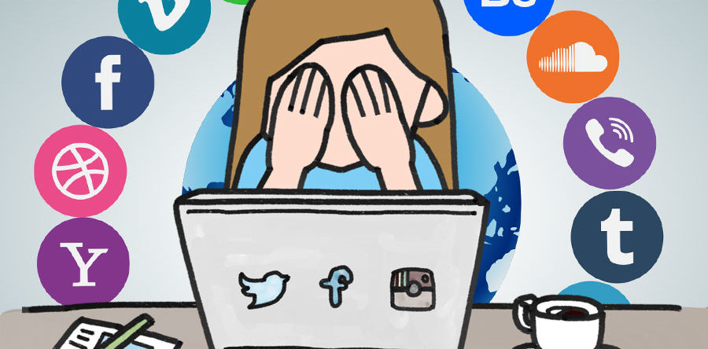
Background
2006 Study: Frequent Tanning Bed Use, Weight Concerns, and Other Health Risk Behaviors in Adolescent Females (United States)
Tanning in a bed 10 or more times were more likely than non-tanning bed users to be concerned about their weight and to have dieted to lose weight
In 2006 little research had been done to examine the association between tanning and other risky behaviors
The association between tanning use and social media needs evaluation to fully grasp how social pressures influence self esteem and participating in unhealthy behaviors

Slide 4
Methods
Target population: college students ranging from age 18-25, in the UMass Amherst area
A descriptive research method was used
A survey was created and carried out on Google forms to collect our data
Distributed surveys to our friends via text message, email, and/or facebook post
Data outcome: 87 participants

Slide 5
Key Findings
People reported spent 3-4 hours on their phone per day.
Most were for social and non-social reason ( social being sharing a post on fb, non-social being looking up the news)
The amount of time spent of their phone per day and if they go tanning or not was not statistically significant.
Body imagine and if they go tanning or not was statistically significant.
Someone who goes tanning due to thinking it make them more attractive was statistically significant.
Those who considered themselves avid social media user and saw themselves more attractive when tan was a negative association so not statistically significant.

Slide 6
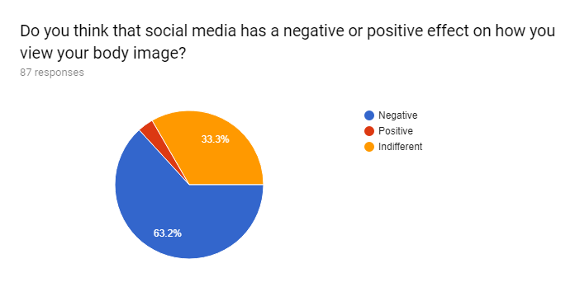
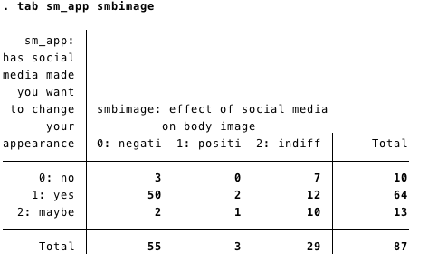
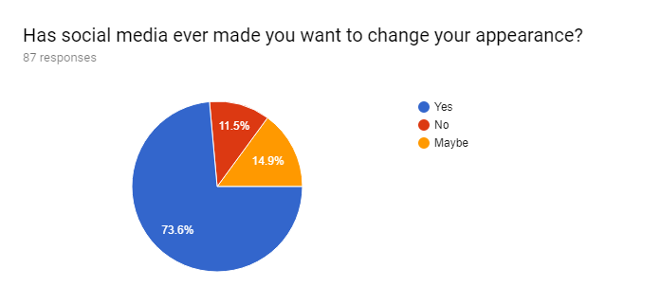
Social Media Use and Body Image Questions

Slide 7
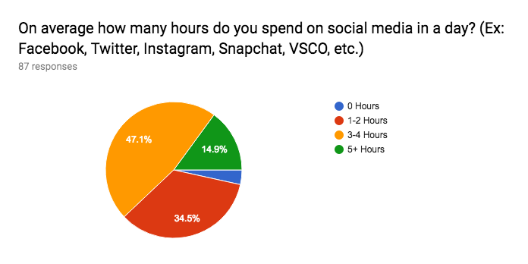
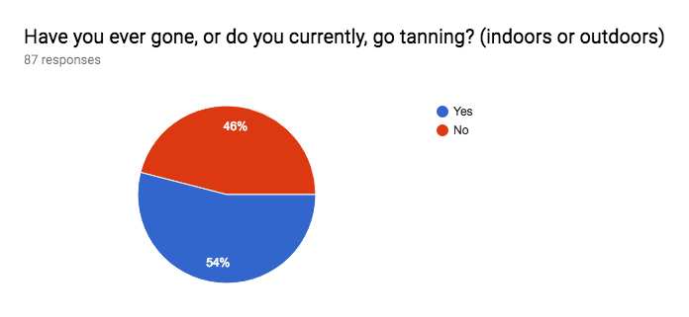
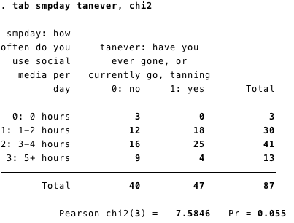
Notes:
From our data we found that on average most people use social media for around 3-4 hours a day with 1-2 hours following right behind.
The results from our chi-square test reported a p value of .055 so we fail to reject the null and it is not statistically significant that the amount of time on social media contributes to to if you have ever gone or currently go tanning.

Slide 8
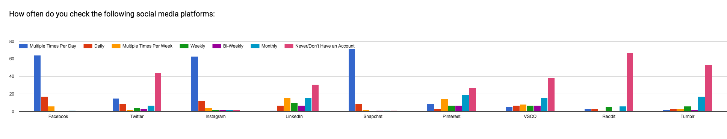
Notes:
We found that, though there was mostly variation amongst how often you visited the different social media platforms

Slide 9
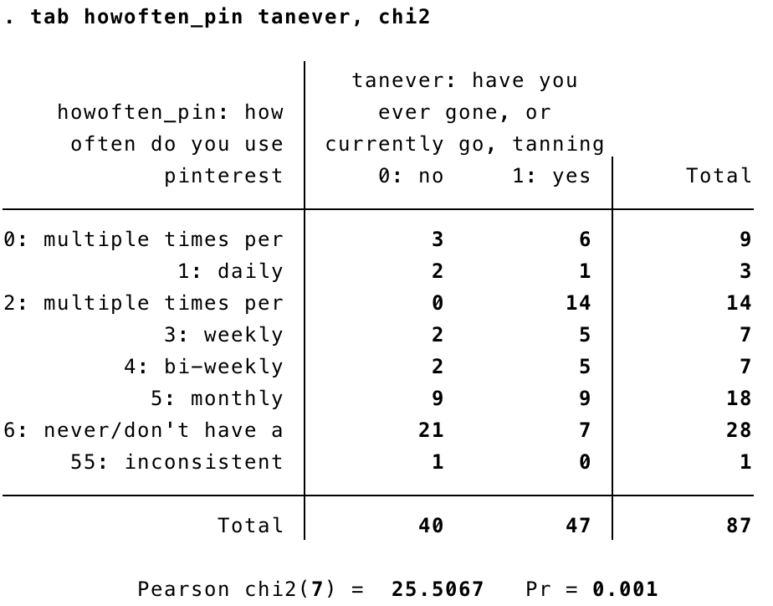
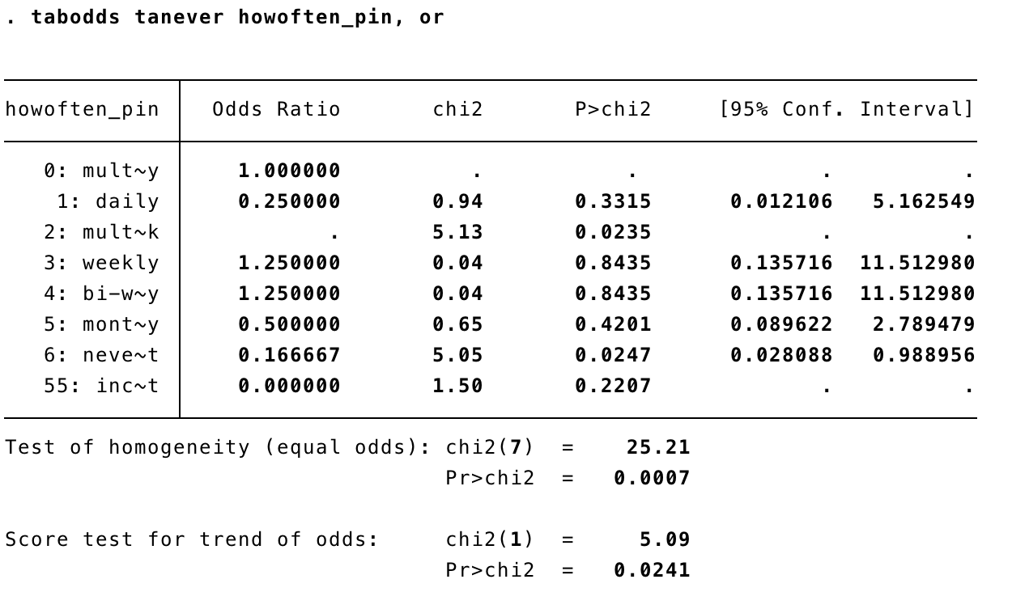
Notes:
the difference in how often you visited pinterest was different whether you had gone, or currently go, tanning or not. Our chi square test resulted in a p value of (0.001) meaning we can reject the null hypothesis, indicating a statistically significant difference between these groups.
When testing for the association between how often you visit pinterest and whether you have gone tanning or currently go, we found odds ratio of (0.1667) for never visiting pinterest with confidence intervals from (0.028 to 0.989). This indicates a statistically significant association between how often you visit pinterest (never) and whether you have gone, or currently go, tanning. The odds of you never visiting pinterest are 16% lower if you have gone, or currently go, tanning compared to if you never go tanning.

Slide 10
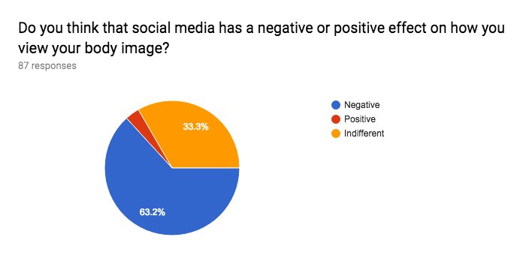
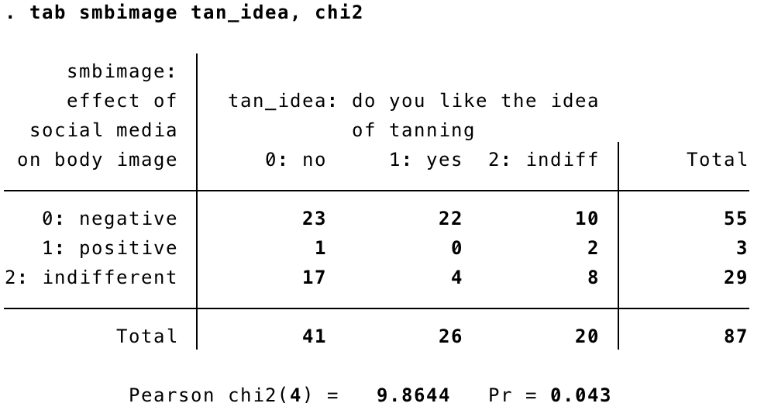
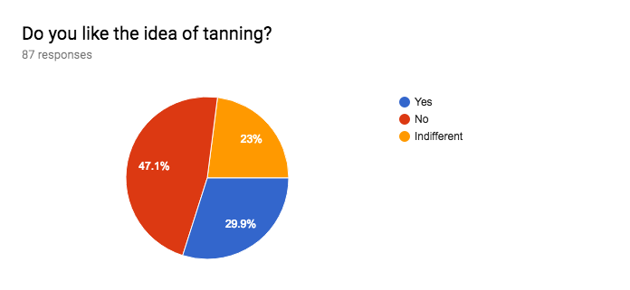
Notes:
The data showed that, for most people, social media had a negative impact on their body image, with the second largest group of people feeling indifferent about it’s impact.
We performed a chi square test between how you feel social media has impacted your body image and whether you like the idea of tanning, and found a p value 0.043. Since this p value is low than the level of significance, we can reject the null hypothesis, indicating a statistical difference in the way social media impacts your body image and whether you like the idea of tanning.

Slide 11
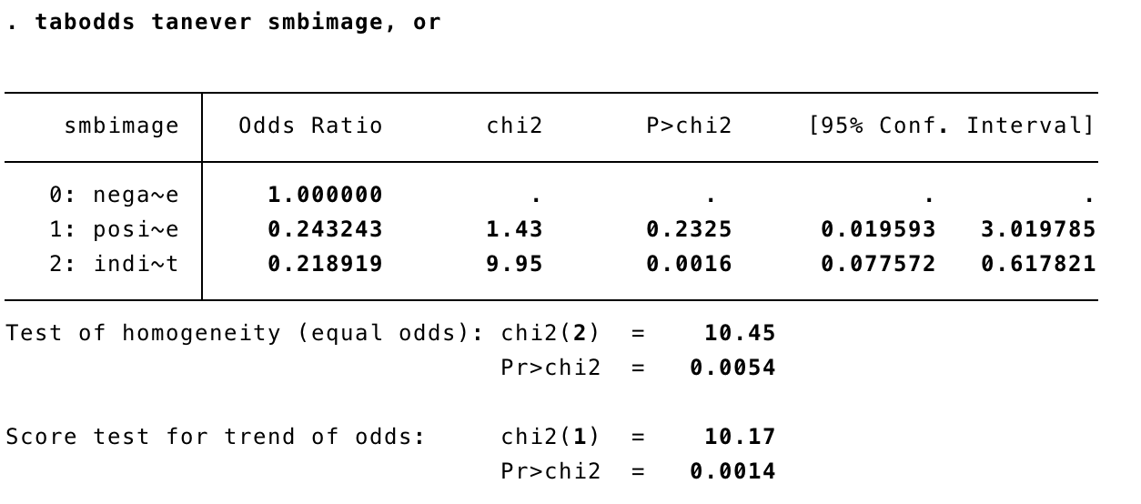
Notes:
When testing for the association between whether you have gone, or currently go, tanning and how social media impacts your body image, we found an odds ratio of (0.219) for feeling indifferent towards the impact social media has on your body image, with confidence intervals from (0.078 to 0.617). This indicates a statistically significant association between whether you have gone, or currently go, tanning and not letting social media impact your body image. The odds of you feeling indifferent towards the way social media impacts your body image, compared to feeling it negatively impacts your body image, is 21.9% lower in people that have gone tanning or currently go, compared to those that do not go at all; this indicates a negative association between social media use, it’s effects on body image, and tanning.

Slide 12
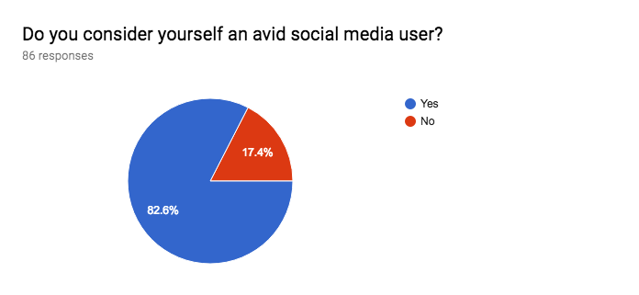
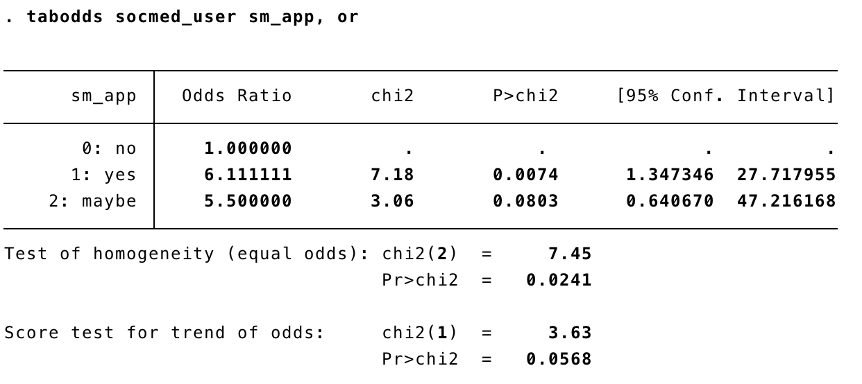

Notes:
We also found that the odds of you feeling social media has influenced you to change your appearance is 6.11% times higher if you consider yourself an avid social media user, compared to those that do not. Since the odds ratio is (6.11) and the confidence intervals are (1.347 to 27.717), this indicates a statistically significant association between using social media and wanting to change your appearance because of it.

Slide 13
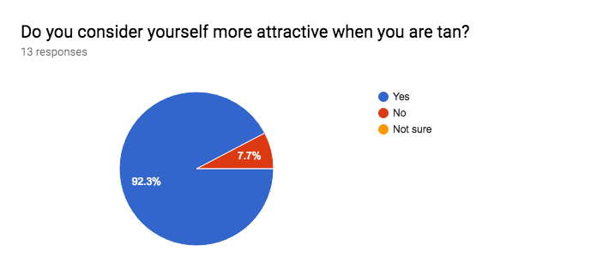
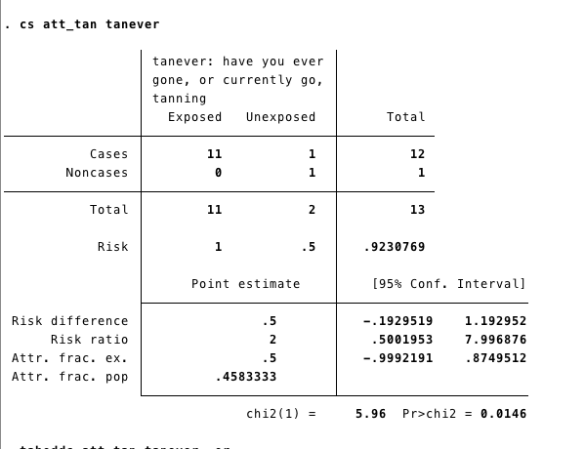
Notes:
We concluded for relative risk that someone who currently tans/has gone tanning are 2 times more likely to consider themselves attractive when tan than those who do not tan so this was statistically significant because there is a positive association.

Slide 14
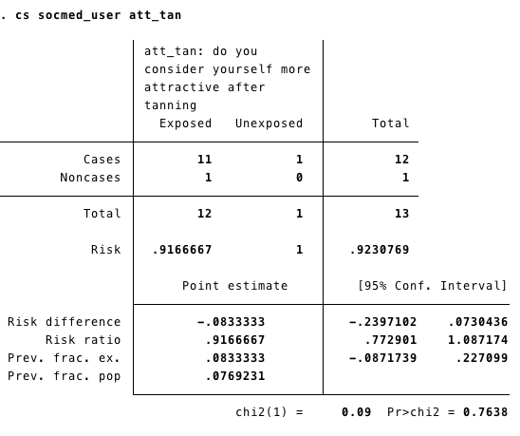
Notes:
We found that the relative risk for someone who considers themselves more attractive when tan was .91 times more likely to believe they were an avid social media user and because this is below 1 this is not significant and would be considered a negative association.

Slide 15
Limitations
Question Errors: working status question, race identification question
Recall Bias: hard for some to remember their history of tanning
Selection Bias: respondents were people that we knew that go to UMass. Our group members are all female and sent the survey out to mostly female participants
Different cultural standards of beauty around the world, this study does not account for these factors

Slide 16
Conclusion
We can conclude social media in its integrity does not affect tanning
However our data suggests there is an association between social media and self image, including avid social media users wanting to change their appearance after using social media

Slide 17
Sources
Picture 1: https://www.google.com/search?q=tanning&source=lnms&tbm=isch&sa=X&ved=0ahUKEwiphf63wOPaAhUFvlkKHXkPBkAQ_AUICygC#imgrc=iGHqH6sYpb1t2M:
Picture 2: https://www.google.com/search?q=social+media&source=lnms&tbm=isch&sa=X&ved=0ahUKEwiXjszOwOPaAhXFxFkKHSh0BT8Q_AUICygC#imgrc=N6HU9HqyEZyJeM:
Picture 3: https://www.google.com/search?q=social+media+and+body+image&source=lnms&tbm=isch&sa=X&ved=0ahUKEwinu_KTwOPaAhUszlkKHSRvCvkQ_AUICygC&biw=970&bih=594#imgrc=DmFh6kszEXA0yM:

